Slide 1

INTERNET CAFE
NETWORK DESIGN PROPOSAL FOR INTERNET CAFE
SHAHID AHAMED BHAVIN SHARMA HITARTH RATHOD KANISHK KUMAR JYOTIRMAAN SRIVASTAVA
RA211003010766 RA211003010768 RA211003010762 RA211003010764 RA211003010798

Slide 2
INTRODUCTION
The objective of this project is to propose a network design solution for an Internet cafe that needs to support 30 users sharing one ADSL internet connection. The cafe also requires a web filtering device or software to restrict access to inappropriate websites and a billing software to manage customer accounts and usage.
The proposed network design solution takes into consideration the cafe's connectivity and management requirements, as well as its need for secure and reliable internet access. The network design solution includes a requirement analysis, a network diagram, an IP address design, and a list of recommended hardware and software products.

Slide 3
REQUIREMENTS
Device | IP Address | Subnet Mask | Default Gateway
PC1-PC30 | 192.168.1.3 to 192.168.1.33 (DHCP) | 255.255.255.0 | 192.168.1.0
PC-ADMIN | 192.168.1.2 (Static) | 255.255.255.0 | 192.168.1.0
Switch 0 | DHCP | DHCP | DHCP
Switch 1 | DHCP | DHCP | DHCP
Lan Router | 200.0.0.1 | 255.255.255.0 | 200.0.0.0
Server0 | 192.168.1.150 | 255.255.255.0 | 192.168.1.0
Server1 | 200.0.0.10 | 255.255.255.0 | 200.0.0.0
ADSL Modem | N/A | N/A | N/A
Cloud | N/A | N/A | N/A
1. Connectivity: The network should support 30 users sharing one ADSL internet connection, with a minimum bandwidth of 20 Mbps.
2. Web filtering: A web filtering device or software should be implemented to restrict access to inappropriate websites and ensure safe and appropriate browsing for customers.
3. Billing software: A billing software should be implemented to manage customer accounts and usage and enable efficient billing.
4. Security: The network should be designed to ensure secure connectivity and prevent unauthorized access.
5. Redundancy and backup: The network should have a backup and redundancy plan in place to ensure continuity of service in case of equipment failure or network outages.
6. Scalability: The network should be scalable to accommodate future growth and expansion.
7. Cost-effectiveness: The network design solution should be cost-effective while still meeting the cafe's requirements and providing reliable and secure connectivity for customers.

Slide 4
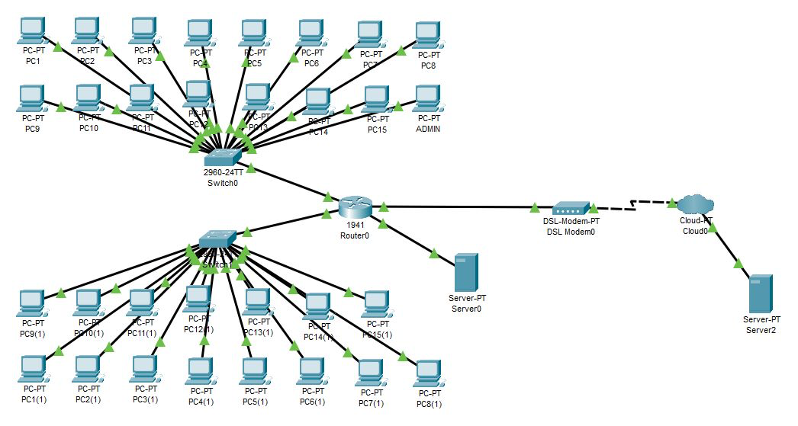
TOPOLOGY

Slide 5
FEATURES
DHCP:
Dynamic Host Configuration Protocols a network protocol that is used to automatically assign IP addresses and other network configuration parameters to devices on a network. This is done dynamically, meaning that addresses are assigned as devices join and leave the network. DHCP makes it easier to manage and set up large networks, and it also reduces the likelihood of IP address conflicts.
VLAN:
VLAN stands for Virtual Local Area Network. It is a network technology that allows for the creation of logical subnetworks within a physical network. VLANs provide an ecient way to group devices, users, and servers that have similar network requirements. Each VLAN can operate as a separate broadcast domain and can be isolated from other VLANs. This allows for better network performance, enhanced security, and easier network management. VLANs are commonly used in large enterprise networks, but they are also gaining popularity in smaller organizations and home networks
SMTP:
SMTP (Simple Mail Transfer Protocol) is a protocol used to send electronic mail messages over the internet. It is a text-based, client-server protocol that allows messages to be exchanged between email servers. SMTP is responsible for the transmission of messages from a sender’s email client to the recipient’s email server. It uses port 25 as its default port, although secured versions, such as SMTPS (Simple Mail Transfer Protocol Secure), use ports 465 or 587. SMTP is an essential component of email communication and is supported by most email clients and servers.
Subnetting:
subnetting is a technique used in network design to divide a single network into multiple smaller subnetworks, or subnets. Each subnet is identified by its own unique network address, which allows for more ecient addressing and routing of network trac. Subnetting is commonly used to improve network performance, security, and manageability, and is an essential skill for network administrators and engineers.

Slide 6
FEATURES
DNS:
DNS stands for Domain Name System. It is a hierarchical and decentralized naming system for computers, services, or other resources connected to the internet or a private network. DNS translates domain names, which are typically easier to remember and use than IP addresses, into their corresponding IP addresses that computers can understand. This process allows users to access websites and other internet resources using memorable domain names instead of having to remember the numerical IP addresses.
WIFI:
Wi-Fi is a wireless networking technology that allows devices to connect to the internet without the need for cables. Wi-Fi uses radio waves to transmit data between devices and works within a range of up to several hundred feet. It is commonly used in homes, businesses, and public spaces to provide internet access to users. Wi-Fi is often preferred over other types of wireless technology due to its speed and reliability.
HTTPS:
HTTP stands for Hypertext Transfer Protocol, which is the foundation of data communication for the World Wide Web. It is a protocol used to transfer data over a secure and encrypted channel, ensuring the integrity and privacy of data being transferred between web servers and browsers. With HTTPS, the information sent between the server and the client is secured by TLS encryption, which helps prevent hackers from intercepting sensitive information such as passwords, credit card numbers, and other personal data.
FTP:
FTP, or File Transfer Protocol, is a standard network protocol used for transferring files from one host to another over a TCP-based network, such as the internet. FTP is often used for uploading web pages and other documents to a server, or for downloading files from a server to a client. FTP operates on two separate channels: a control channel, which is used to authenticate and coordinate the transfer, and a data channel, which is used to transfer the actual files.

Slide 7
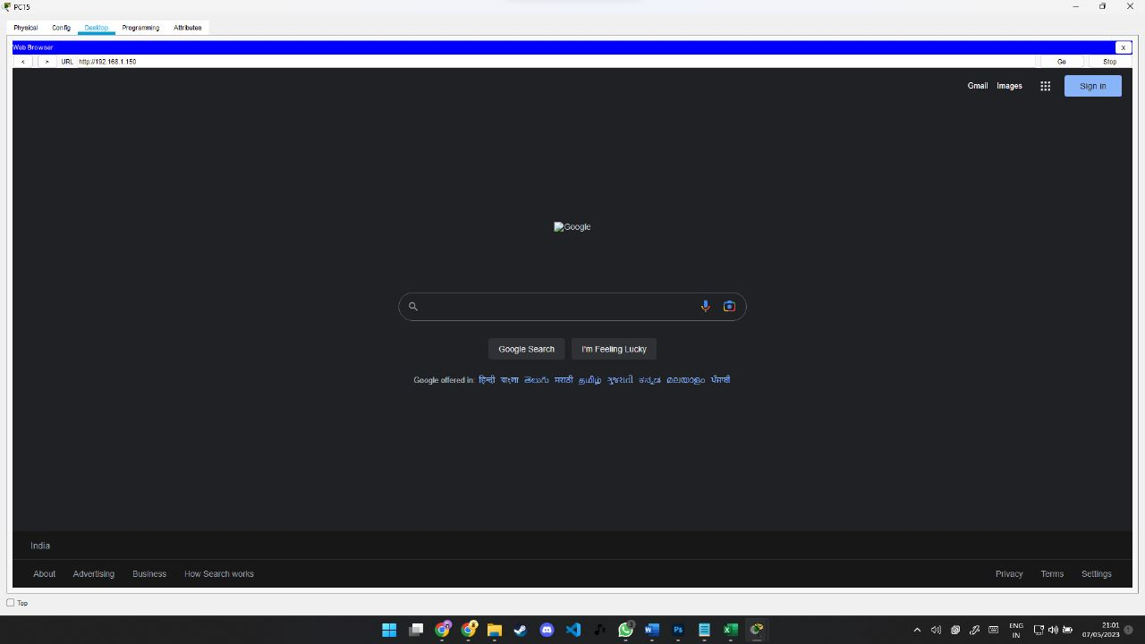
RUNTIME DEMO
Once the network design is implemented and configured, the PCs in the Internet cafe should be able to access the internet through the server. This can be verified by opening a web browser on a PC and attempting to navigate to a website. If successful, the website should load and the user should be able to browse the internet. The speed and reliability of the internet connection may depend on factors such as the ISP, the network hardware, and the number of users accessing the internet simultaneously. Any issues with connectivity should be addressed promptly to ensure the best possible experience for customers.

Slide 8

Cost-Benefit Analysis
The proposed network design is expected to have a high initial cost but will result in a significant return on investment. The fast and stable connection will attract more customers and increase revenue. Additionally, the implementation of security measures will reduce the risk of data breaches and potential legal liabilities.
Based on the cost-benefit analysis, the proposed network design for the Internet cafe is a cost-effective investment that will enhance the security of the cafe, improve the customer experience, and increase revenue.

Slide 9

SECURITY MEASURES
The proposed security measures include a firewall to protect against external threats and a content filtering system to prevent access to malicious or inappropriate websites. Additionally, the network will be segmented to isolate customers from sensitive administrative systems.

Slide 10
CONCLUSION
In conclusion, the proposed network design solution for the Internet cafe with 30 users is aimed at meeting the cafe's requirements for secure, reliable, and efficient internet connectivity, as well as effective management of customer accounts and usage. The solution includes a web filtering device or software to ensure safe browsing for customers, as well as a billing software to streamline the cafe's billing process.
The network design solution also includes a comprehensive requirement analysis, network diagram, IP address design, and recommendations for hardware and software products. These elements work together to provide a scalable, secure, and cost-effective network infrastructure that meets the cafe's current and future needs.

Slide 11
THANK YOU!

